Slide 1
Machine Learning
Naïve Bayes Classification

Slide 2
Opening Questions
What is a Naïve Bayes Classifier?
What can we use Naïve Bayes Classifiers for?
What is posterior probability and how it is applied in Naïve Bayes Classifiers?

Slide 3
Background
When a meteorologist in the US provides a weather forecast, precipitation is typically predicted using terms such as "70 percent chance of rain".
These estimates are based on probabilistic methods, or methods concerned with describing uncertainty. They use data on past events to extrapolate future events.
In the case of weather, the chance of rain describes the proportion of prior days with similar measurable atmospheric conditions in which precipitation occurred.
A 70 percent chance of rain therefore implies that in 7 out of 10 past cases with similar weather patterns, precipitation occurred somewhere in the area.

Slide 4
Introduction
Naïve Bayes is a statistical classification technique that is based on Bayes Theorem. It is one of the simplest supervised learning algorithms.
Naïve Bayes uses Bayes theorem of probability for prediction of unknown class.
Naïve Bayes classifiers have high accuracy and speed on large datasets.
Somethings will we cover:
  Basic principles of probability that are utilized for Naïve Bayes

Slide 5
Introduction
Naïve Bayes uses data about prior events to estimate the probability of future events.
  For instance, a common application of naïve Bayes for spam filtering uses the frequency of words in past junk email messages to identify new junk mail.
Naïve Bayes classifier assumes that the effect of a particular feature in a class is independent of other features
This assumption simplifies computation, and that's why it is considered as Naïve.
This assumption is called class conditional independence

Slide 6
Introduction
Classifiers based on Bayesian methods makes use of training data to calculate an observed probability of each class based on feature values.
When the classifier is used later on unlabeled data (test data), it uses the observed probabilities to predict the most likely class for the new features.
It's a simple idea, but it results in a method that often has results on par with more sophisticated algorithms.

Slide 7
Introduction
Bayesian classifiers have been used for:
  Text classification, such as junk email (spam) filtering, author identification, or topic categorization
  Sentiment analysis
  Intrusion detection or anomaly detection in computer networks
  Diagnosing medical conditions, when given a set of observed symptoms
  Recommender systems
Typically, Bayesian classifiers are best applied to problems in which the information from numerous attributes should be considered simultaneously in order to estimate the probability of an outcome.

Slide 8
Introduction
While many algorithms ignore features that have weak effects, Bayesian methods utilize all available evidence to subtly change the predictions.
If a large number of features have relatively minor effects, taken together their combined impact could be quite large.
Bayesian probability theory is rooted in the idea that the estimated likelihood of an event should be based on the evidence at hand.
  Events are possible outcomes, such as sunny and rainy weather, a heads or tails result in a coin flip, or spam and not spam email messages.
  A trial is a single opportunity for the event to occur, such as a day's weather, a coin flip, or an email message.

Slide 9
Probability
The probability of an event can be estimated from observed data by dividing the number of trials in which an event occurred by the total number of trials.
  For instance, if it rained 3 out of 10 days, the probability of rain can be estimated as 30 percent (30%).
  Similarly, if 10 out of 50 email messages are spam, then the probability of spam can be estimated as 20 percent (20%).
The notation P(A) is used to denote the probability of event A, as in P(spam) = 0.20.
If the trial only has two outcomes that cannot occur simultaneously, such as heads or tails, or spam and ham (non-spam), then knowing the probability of either outcome reveals the probability of the other.
  For example, given the value P(spam) = 0.20, we are able to calculate
P(ham) = 1 – 0.20 = 0.80.
  This works because the events spam and ham are mutually exclusive and exhaustive.

Slide 10
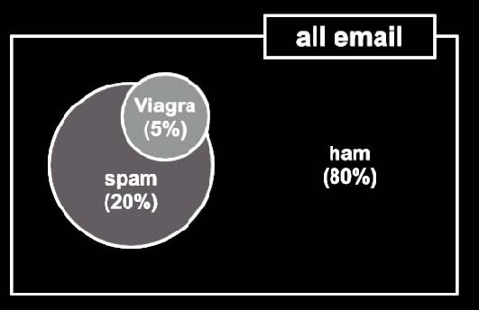
Joint Probability
Often, we are interested in monitoring several non-mutually exclusive events for the same trial. If some events occur with the event of interest, we may be able to use them to make predictions.
Consider, for instance, a second event based on the outcome that the email message contains the word Viagra.
For most people, this word is only likely to appear in a spam message; its presence in a message is therefore a very strong piece of evidence that the email is spam.
The Viagra circle does not completely fill the spam circle, nor is it completely contained by the spam circle.
This implies that not all spam messages contain the word Viagra, and not every email with the word Viagra is spam.

Slide 11
Joint Probability
We know that 20% of all messages were spam and 5% of all messages contained Viagra.
  Our job is to quantify the degree of overlap between these two proportions.
In other words, we hope to estimate the probability of both P(spam) and P(Viagra)
occurring, which can be written as P(spam ∩ Viagra).
Calculating P(spam ∩ Viagra) depends on the joint probability of the two events, or how the probability of one event is related to the probability of the other.
If the two events are totally unrelated, they are called independent events.
  For instance, the outcome of a coin flip is independent from whether the weather is rainy or sunny.
If all events were independent, it would be impossible to predict any event using the data obtained by another. On the other hand, dependent events are the basis of predictive modeling.
  For instance, the presence of clouds is likely to be predictive of a rainy day, and the appearance of the word Viagra is predictive of a spam email.

Slide 12
Joint Probability – Independence
If we assume that P(spam) and P(Viagra) were independent, we could then easily calculate P(spam ∩ Viagra); the probability of both events happening at the same time. NOTE that they are however not independent!
Because 20 percent of all messages are spam, and 5 percent of all emails contain the word Viagra, we could assume that 5 percent of 20 percent (0.05 * 0.20 = 0.01), or 1 percent of all messages are spam containing the word Viagra.
More generally, for independent events A and B, the probability of both happening is P(A ∩ B) = P(A) * P(B).
In reality, it is far more likely that P(spam) and P(Viagra) are highly dependent, which means that this calculation is incorrect. So we need…

Slide 13
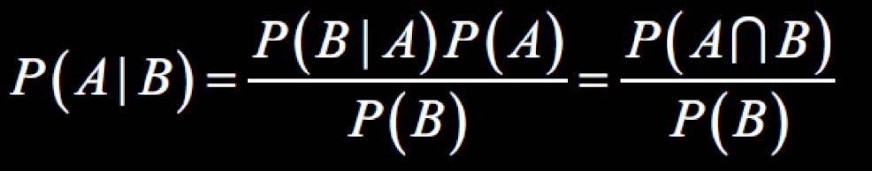
Conditional Probability
The relationships between dependent events can be described using
Bayes‘ Theorem, as shown in the following formula.
The notation P(A|B) can be read as the probability of event A given that
event B occurred.
This is known as conditional probability, since the probability of A is dependent (that is, conditional) on what happened with event B.

Slide 14
Probability – Example
Suppose that you were tasked with guessing the probability that an incoming email was spam.
Without any additional evidence, the most reasonable guess would be the probability that any prior message was spam (that is, 20 percent in the
preceding example).
It describes the degree to which we believe the model accurately describes reality based on all of our prior information
This estimate is known as the prior probability.
Now, also suppose that you obtained an additional piece of evidence; you were told that the incoming message used the term Viagra.
The probability that the word Viagra was used in previous spam messages is called the likelihood and the probability that Viagra appeared in any message at all is known as the marginal likelihood

Slide 15
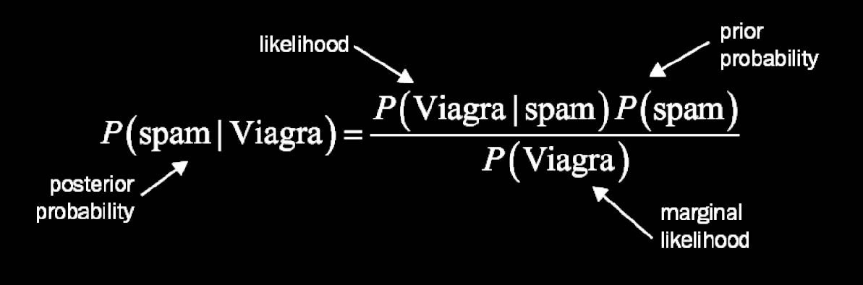
Probability – Example
By applying Bayes' theorem to this evidence, we can compute a posterior probability that measures how likely the message is to be spam.
If the posterior probability is greater than 50 percent, the message is more likely to be spam than ham, and it can potentially be filtered.
The following formula is the Bayes' theorem for the given problem:

Slide 16
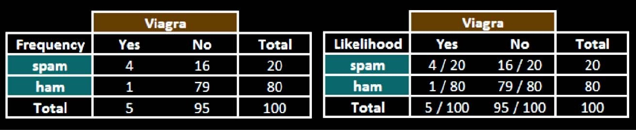






Probability – Example
We need information on how frequently Viagra has occurred as spam or ham.
Now, Lets assume these numbers:
The likelihood table reveals that P(Viagra|spam) = 4/20 = 0.20, indicating that the probability is 20 percent that a spam message contains the term Viagra.
Additionally, since the theorem says that P(B|A) * P(A) = P(A ∩ B), we can calculate
P(spam ∩ Viagra) as P(Viagra|spam) * P(spam) = (4/20) * (20/100) = 0.04.

Slide 17
Probability – Example
Also, to compute the posterior probability, P(spam|Viagra), we simply take
P(Viagra|spam) * P(spam) / P(Viagra), or (4/20) * (20/100) / (5/100) = 0.80.
Therefore, the probability is 80 percent that a message is spam, given that it contains the word Viagra.
Therefore, any message containing this term should be filtered.
This is very much how commercial spam filters work, although they consider a much larger number of words simultaneously when computing the frequency and likelihood tables.

Slide 18
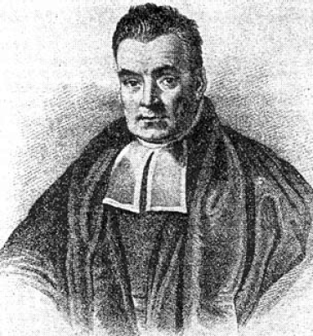

Naïve Bayes
The naïve Bayes algorithm is named as such because it makes a couple of naïve assumptions about the data.
  In particular, Naïve Bayes assumes that all of the features in the dataset are equally important and independent.
  These assumptions are rarely true in most of the real- world applications.
However, in most cases when these assumptions are violated, naïve Bayes still performs fairly well.
This is true even in extreme circumstances where strong dependencies are found among the features.
Due to the algorithm's versatility and accuracy across many types of conditions, naïve Bayes is often a strong first candidate for classification learning tasks.

Slide 19
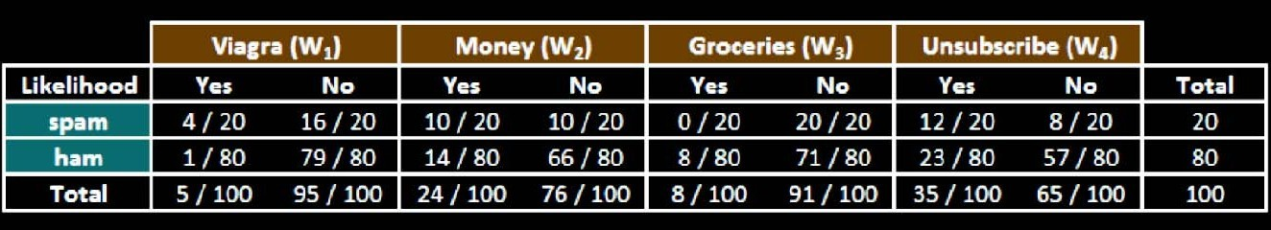




Naïve Bayes – Example
Let's extend our spam filter by adding a few additional terms to be monitored: money, groceries, and unsubscribe.
The Naïve Bayes learner is trained by constructing a likelihood table for the appearance of these four words (W1, W2, W3, and W4), as shown in the following diagram for 100 emails:
As new messages are received, the posterior probability must be calculated to determine whether they are more likely spam or ham, given the likelihood of the words found in the message text.
  For example, suppose that a message contains the terms Viagra and Unsubscribe, but does not contain either Money or Groceries

Slide 20
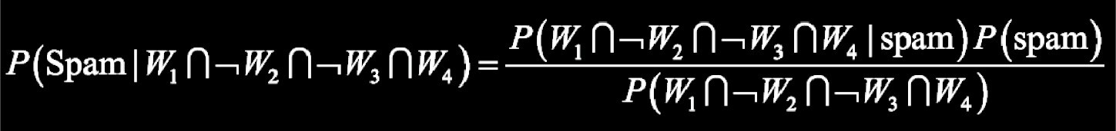
Naïve Bayes – Example
Using Bayes' theorem, we can define the problem as shown in the following formula, which captures the probability that a message is spam, given that: Viagra = Yes, Money = No, Groceries = No, and Unsubscribe = Yes:
For a number of reasons, this formula is computationally difficult to solve. As additional features are added, tremendous amounts of memory are needed to store probabilities for all of the possible intersecting events; imagine the complexity of a Venn diagram for the events for four words,
……………….. let alone for hundreds or more…

Slide 21
Naïve Bayes – Example
Using the values in the likelihood table, we can start filling numbers in these equations. Because the denominator is the same in both cases, it can be ignored for now.
The overall likelihood of spam is then:
(4/20) * (10/20) * (20/20) * (12/20) * (20/100) = 0.012
While the likelihood of ham given this pattern of words is:
(1/80) * (66/80) * (71/80) * (23/80) * (80/100) = 0.002
Because 0.012 / 0.002 = 6, we can say that this message is six times more likely to be spam than ham.
However, to convert these numbers to probabilities, we need one last step.
The probability of spam is equal to the likelihood that the message is spam divided by the likelihood that the message is either spam or ham:
0.012 / (0.012 + 0.002) = 0.857

Slide 22
Naïve Bayes – Problems
Suppose we received another message, this time containing the terms: Viagra, Money, Groceries and Unsubscribe. The likelihood table of spam is:
(4/20) * (10/20) * (0/20) * (12/20) * (20/100) = 0
Surely this is a misclassification? Right?
This problem might arise if an event never occurs for one or more levels of the class.
  For instance, the term Groceries had never previously appeared in a spam message
  Consequently, P(spam|groceries) = 0%.
Because probabilities in naïve Bayes are multiplied, this 0 percent value causes the posterior probability of spam to be zero, giving the word Groceries the ability to effectively nullify and overrule all of the other evidence.
Even if the email was otherwise overwhelmingly expected to be spam, the absence of the word Groceries will always result in a probability of spam being zero.

Slide 23
Naïve Bayes – Laplace Estimator
A solution to this problem involves using something called the Laplace estimator, which is named after the French mathematician Pierre-Simon Laplace.
The Laplace estimator essentially adds a small number to each of the counts in the frequency table, which ensures that each feature has a nonzero probability of occurring with each class.
Typically, the Laplace estimator is set to 1, which ensures that each class-feature combination is found in the data at least once.
  The Laplace estimator can be set to any value, and does not necessarily even have to be the same for each of the features.

Slide 24
Naïve Bayes – Laplace Estimator
Using a Laplace value of 1, we add one to each numerator in the likelihood function. The total number of 1s must also be added to each denominator.
The likelihood of spam is therefore:
(5/24) * (11/24) * (1/24) * (13/24) * (20/100) = 0.0004
And the likelihood of ham is:
(2/84) * (15/84) * (9/84) * (24/84) * (80/100) = 0.0001
This means that the probability of spam is 80 percent and the probability of ham is 20 percent; a more plausible result than the one obtained when Groceries alone determined the result.

Slide 25
Naïve Bayes – Numeric Features
Because Naïve Bayes uses frequency tables for learning the data, each feature must be categorical in order to create the combinations of class and feature values comprising the matrix.
Since numeric features do not have categories of values, the preceding algorithm does not work directly with numeric data.
One easy and effective solution is to discretize numeric features, which simply means that the numbers are put into categories known as bins.
  For this reason, discretization is also sometimes called binning.
  This method is ideal when there are large amounts of training data, a common condition when working with Naïve Bayes.

Slide 26
Naïve Bayes – Python
Naïve Bayes is available in the scikit-learn library: sklearn.Naïve_bayes
Below are some of the implementations of Naïve Bayes model:
  GaussianNB: Gaussian Naïve bayes is good at handling continuous values. It implements the Gaussian Naïve Bayes algorithm for classification.
  MultinomialNB: Multinomial Naïve bayes is good at handling discrete values. It implements the Naïve Bayes algorithm for multinomially distributed data, and is one of the two classic Naïve Bayes variants used in text classification (where the data are typically represented as word vector counts, although TF-IDF (Term Frequency-inverse Document Frequency) vectors are also known to work well in practice).
  BernoulliNB: Bernoulli Naïve bayes is good at handling boolean/binary attributes. It implements the Naïve Bayes training and classification algorithms for data that is distributed according to multivariate Bernoulli distributions; i.e., there may be multiple features but each one is assumed to be a binary-valued (Bernoulli, boolean) variable.

Slide 27
Summary
Naïve Bayes is:
  A probabilistic classification model based on applying Bayes’ theorem with the “Naïve” assumption of conditional independence between every pair of features given the value of the class variable
  Really easy to implement and often works well
  Often a good first thing to try
  Commonly used as a “punching bag” for smarter algorithms.

Slide 28
Exercise
Scenario: Email Spam Classification
You are using Naive Bayes to classify emails as spam or not spam.
Questions:
How does the Naive Bayes assumption of feature independence affect model performance in this scenario?
How would you handle words that appear in the test dataset but not in the training dataset?
If some features are highly correlated (e.g., “free” and “offer”), how might that impact predictions, and what could you do about it?

